Slide 1
The Chinese Civil War And The Emergence Of Mao’s Authoritarian State
Part 1

Slide 2
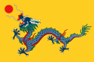
Historical background 1911-1928
The Qing dynasty
China was historically a conservative nation led by powerful emperors.
Collectivism and Confucianism were two philosophies that guided Chinese society for centuries.
Chinese culture has always been a collective one where the group was at the centre of everything (for example, people always ate and worked together) while Confucianism was a code of conduct Chinese people had to follow in order to live a harmonious life.
In 1644 ethnic Manchus from the north of China defeated the majority ethnic Hans and replaced the Ming dynasty, with the Qing (Ch’ing) dynasty. The Qing dynasty lasted until 1911.

Slide 3
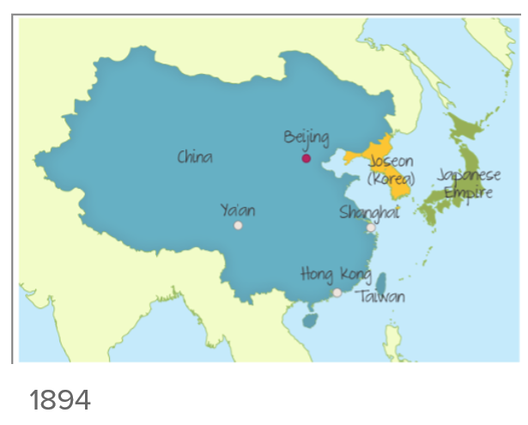
Historical background 1911-1928
During the eighteenth century, under the Qing, the country prospered. Foreign trade with the West expanded with China exporting tea and silk, population increased and the arts flourished.
By the 19th century, the situation started to deteriorate. There were rebellions (Taiping) and the opium wars against Western powers.
The defeat in the Sino–Japanese War in 1894 was a humiliating experience for China, who had always seen itself as the most powerful nation in South East Asia.
Japan, under Emperor Meiji, began a period of political, economic, social and military change which led to the creation of a powerful nation by the beginning of the 20th century.
Meanwhile, China was at the mercy of corrupt officials and conservative rulers who did not embrace change until decades later.

Slide 4
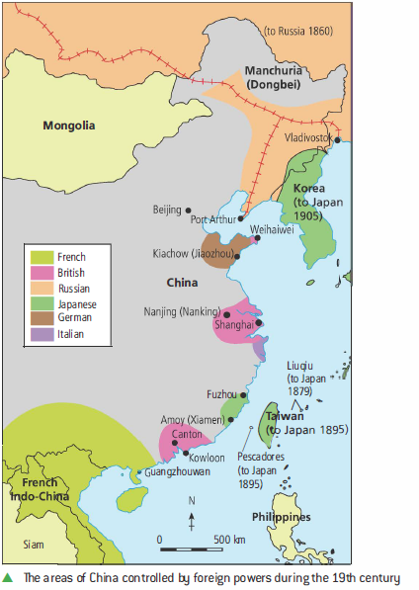
Historical background 1911-1928
After the defeat of China in the Sino–Japanese war, European nations which already had influence in China continued their territorial expansion.
Territories like Hong Kong island, Kowloon and the New Territories became under the control of Britain and Outer Mongolia came under the influence of Russia.
The weakness of the Qing against Western dominance increased the resentment towards foreigners and the Manchus and in 1900 a famous uprising known as the ‘Boxer Rebellion’ rose against both.

Slide 5
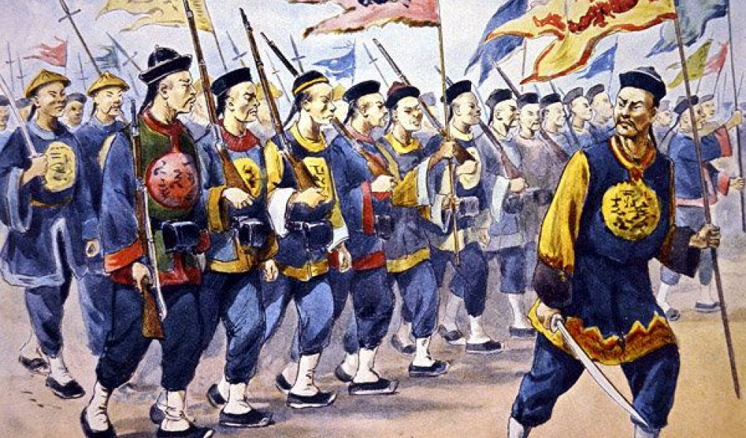
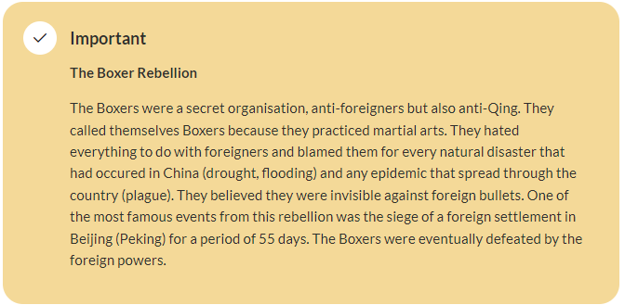

Slide 6
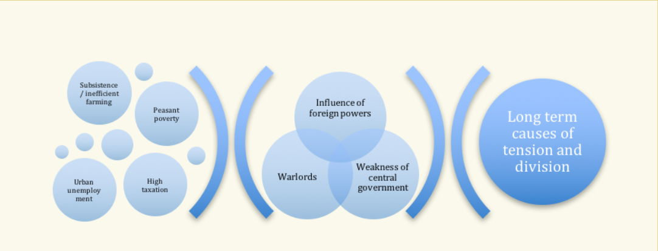

Slide 7
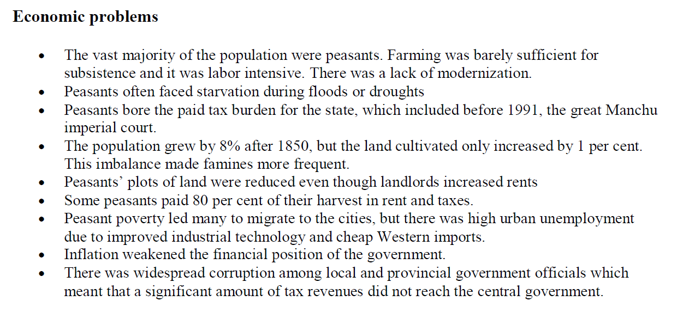
Long term causes of tension and division

Slide 8
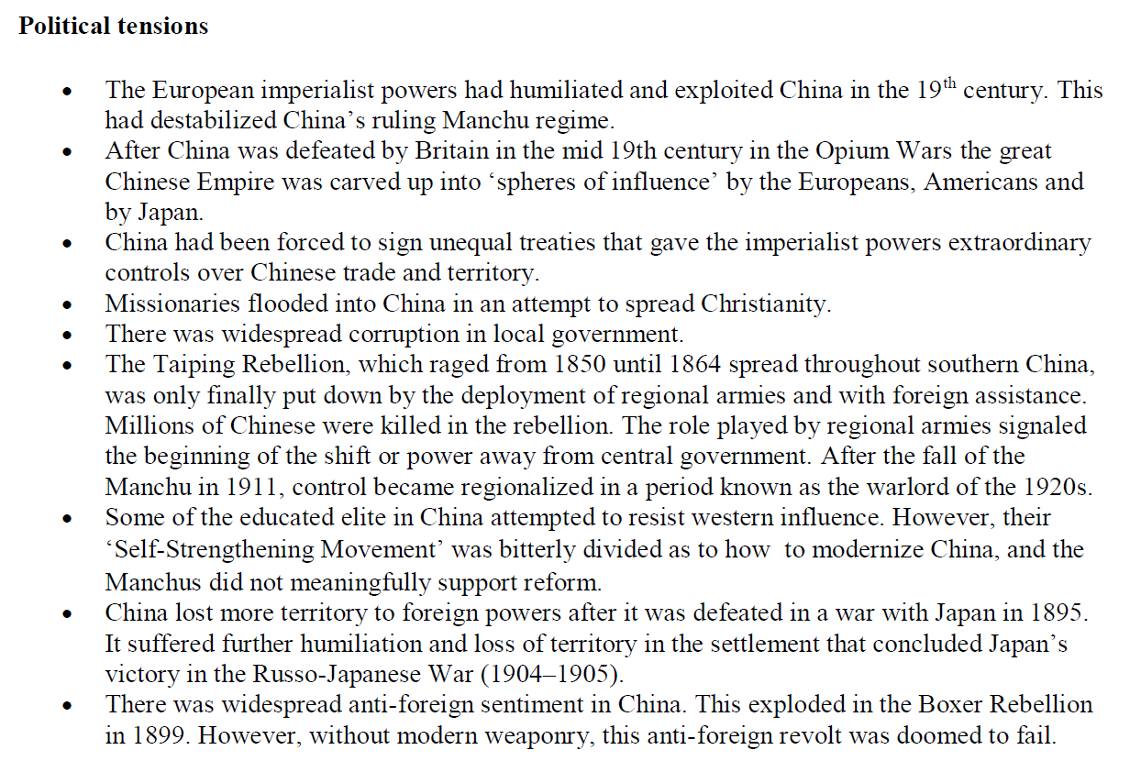
Long term causes of tension and division

Slide 9
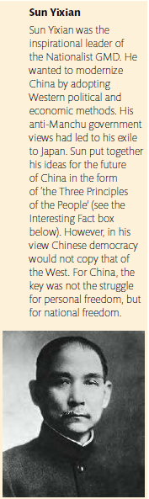
Historical background 1911-1928
The Xinhai Revolution and the early Republic of China
The Xinhai Revolution, or the 10-10 Revolution, of 10 October 1911 led to the overthrow of the Qing dynasty and the establishment of the Republic of China under the presidency of Sun Yixian (Sun Yat-sen).
Unfortunately, Sun Yixian kept his position as president less than a year. The new Chinese republic could only survive with a strong military back up that Yixian did not have at that time.
General Yuan Shikai had the monopoly on military power and in order to secure the new democracy in China, Sun Yuxian handed him the presidency. This was short lived as Yuan was more interested in ruling as a monarch than a president and in 1916, he proclaimed himself emperor for one hundred years. The new Emperor died three months later leaving the country with neither a strong leader nor a strong government to rule.
The Republican government tried to survive under the authority of Duan Qirui (Tuan Ch'i-jui); however, it did not have enough real power to impose political control over the warlords ruling over the provinces.

Slide 10
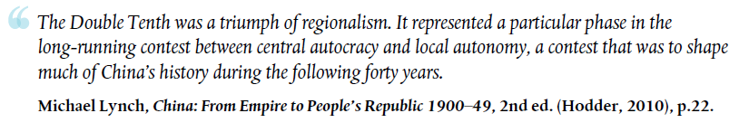

Slide 11

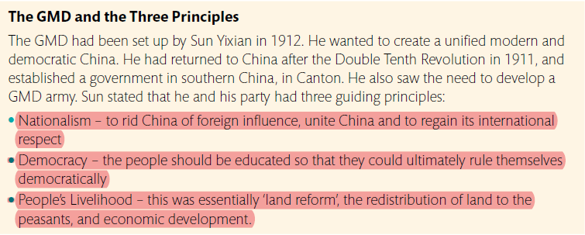
The rule of Yuan Shikai
Yuan ruled China as a military dictator from 1912 until 1915. Regionalism continued under Yuan’s rule and became the key obstacle to a united China. Sun’s party reformed as the Guomindang (GMD) in 1912, and declared itself a parliamentary party.
It is argued that Sun agreed to Yuan Shikai’s rule in order to avert the possibility of China descending into civil war. The republicans were not powerful enough at this stage to take on the military. It was a lesson that both the GMD and the Chinese
Communists would take on board – to win the political battle for China you needed military power. Sun attempted to undermine Yuan’s power by moving him from his power base in Beijing to the south in Nanjing to set up a new government. Yuan refused to leave.
At this point the GMD was a regional power only in the southern provinces, and the republicans were not sufficiently organized to mount resistance to Yuan. A ‘second revolution’ failed and Sun had to flee to Japan in 1913. However, Yuan mastered his own downfall by a series of ill-conceived acts. The 1912 Republican constitution had created regional assemblies, which he abolished in an attempt to centralize power.
This act further alienated the provincial powers, especially as tax revenues were centrally controlled. Yuan’s final miscalculation was to proclaim himself emperor in 1916. At this point he lost the support of the military and stood down. He died three months later.

Slide 12
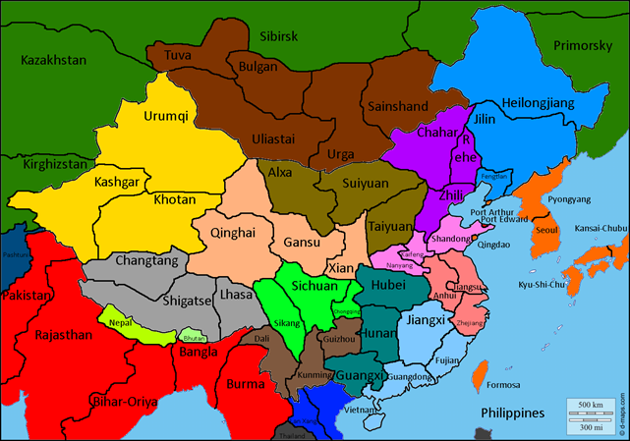
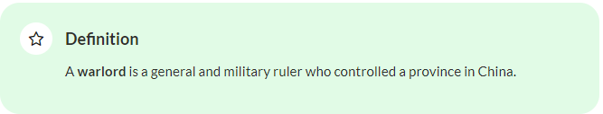
The period of the warlords 1916–28
The death of Yuan Shikai and the absence of a strong central government led to the fragmentation of China into semi-independent provinces each under the control of the feudal warlords. This period lasted from 1916 to 1928.
Under the rule of the warlords living conditions were challenging. Many people, especially peasants, experienced exploitation, corruption, unemployment, inflation and famine.
The main objectives of most warlords were to gain territory, power and wealth no matter the cost. Very few tried to improve the lives of their people but there were some exceptions.
For example, Yan Xishan known as the ‘Model Governor’ ruled his province Shanxi very differently. He implemented welfare programmes and agricultural reforms. While Feng Yuxiang, known as the Christian General for converting his troops to Christianity using a fire hose, prohibited opium and condemned foot binding.
Warlord Era | 3 Minute History

Slide 13
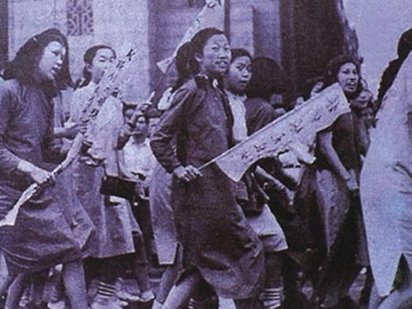
May Fourth Movement
In 1914 when World War I started in Europe, the Triple Entente countries put pressure on China to declare war on Germany. China remained neutral but by 1916 was sending men to repair tanks and do other tasks to help to repair the war’s battle sites (Boisonneault, Smithsonian Magazine). There were about 150,000 Chinese volunteers who went to the front in Europe.
Many believed that their behaviour would be rewarded and that China would regain the sovereignty of Shandong which had been under German control.
To the Chinese’s dismay, when the war was over, Shandong was transferred to the sovereignty of Japan. This sparked deep feelings of resentment against both Japan and the Western powers and generated a youth, anti-imperialist movement known as the May Fourth Movement.
Over 3,000 students marched on the streets of Beijing to protest against the outcome of the Treaty of Versailles. Many Chinese intellectuals and thinkers started losing faith in the democratic system and developing some more radical ideas. The ‘May Fourth Movement’ therefore played a critical role in the creation of the Chinese Communist Party.
Mao Zedong, a fervent nationalist, began to see Marxism as a way to fulfill his dream of unifying China which democracy had failed to do. You can read more about this perspective in the article 'Betrayed Ally: how China was snubbed after World War I'.

Slide 14
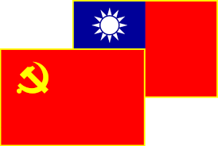
Communists and Nationalists
By the time Sun died in 1925, the GMD had made little progress towards fulfilling the ‘Three Principles’. The party had been limited by lack of influence beyond the south, and the fact it had to rely on alliances with warlords due to the weakness of its military power.
After the death of Sun, General Jiang Jieshi, a committed Nationalist and enthusiastic GMD member, took over leadership of the GMD. He had received military training before World War One in Japan, and then in the new Communist state of the USSR.
The Soviet leadership of the USSR had begun to invest in the GMD, providing aid and assistance to the party. The Soviets believed they could foster good relations with a Nationalist China. The Chinese Communist Party (CCP) was officially set up in 1921; initially, its membership was mainly intellectuals, and it had no real military strength.
It was due to this weakness, and some shared aims, that the CCP agreed to work with the GMD. It was also consistently encouraged to cooperate with the Nationalists by the new Soviet state, the USSR.

Slide 15
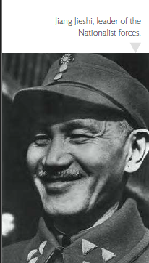
Attempt to unify China: the First United Front The enemy of my enemy is my friend!
Historical background 1927-1949
Both the GMD and the CCP wanted a unified China. They agreed that the first step to this was to get rid of the warlords, and in 1922 they formed the First United Front.
Both parties also agreed that China needed to be free of the foreign imperialist powers. The Third Principle of Sun Yixian, ‘the People’s Livelihood’, was often called ‘socialism’, which convinced the Comintern that this was a party they could back. In addition, Jiang had studied in Moscow in 1923, and then ran the Whampoa Military Academy, which was set up and funded by the USSR to train GMD officers.
Despite his Soviet links, however, Jiang was not a Communist. Indeed, he became increasingly anti-Communist, and began his leadership of the GMD by removing Communists from key positions in the party. He stopped short of breaking off the alliance with the Communists, as he knew that he must first take out his primary obstacle to a unified China – the warlords.
Jiang now determined to act on the first of the Three Principles and attempt to unify China by putting an end to the warlords’ power. Together with the Communists, the GMD set out on the ‘Northern Expedition’ in 1926 to crush the warlords of central and northern China.
This operation was a great success; by 1927, the GMD and the Communists had captured Hangzhou, Shanghai, and Nanjing. They took Beijing in 1928. Within 2 years, the United Front of the GMD and the CCP had destroyed the power of the warlords, and the GMD announced that it was the legitimate government of China and the new capital and seat of government would be Nanjing.

Slide 16
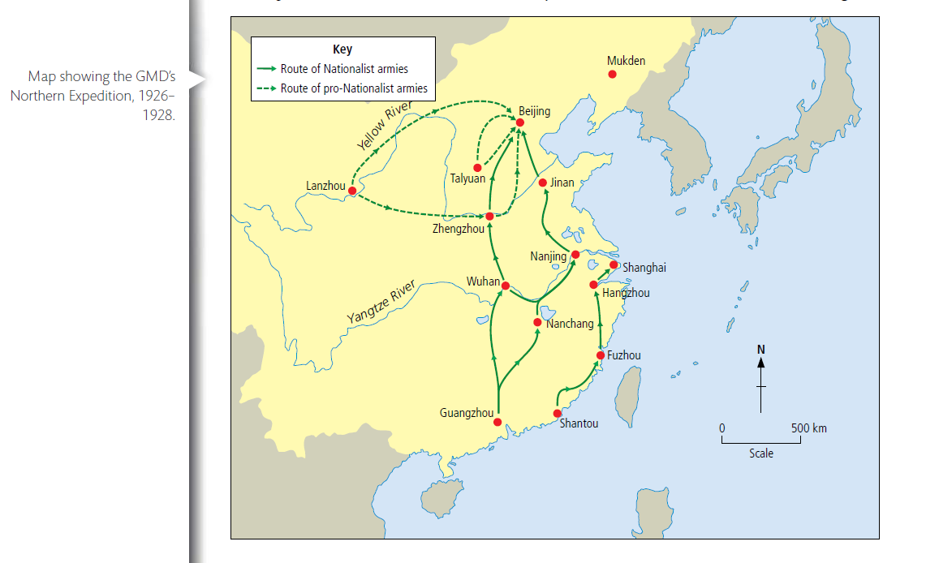
Attempt to unify China: the First United Front My enemy of my enemy is my friend!

Slide 17
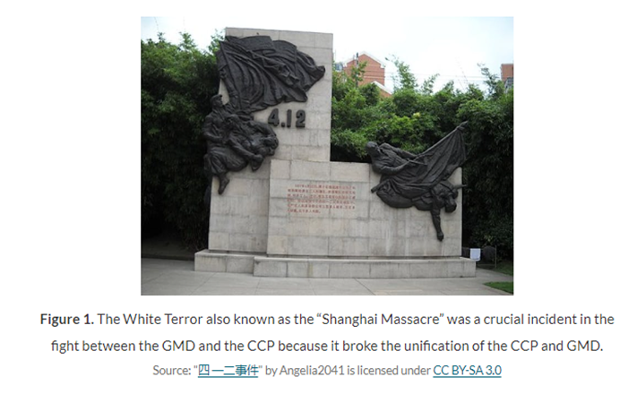
End of the First United Front: the GMD attacks the CCP
Historical background 1927-1949
Despite the results of the Northern Expedition, China was not now unified. The United Front was only a friendship of convenience. What had united the CCP and the GMD – the fight against the warlords – was over, and ideology divided the two parties.
The success of the Northern Expedition had been not only due to Nationalist ambitions. It was also because of the Communist promise of land to the peasants; this commitment had given them local peasant support. The Communists also had support from the industrial workers: for example, Zhou Enlai, a Communist member of the GMD, had organized the workers rising in Shanghai.
The popular support for the Communists was a key reason that Jiang decided he could no longer tolerate them in the GMD. There could be no more cooperation. Jiang was sympathetic to landlords and the middle classes, and was far more to the right than Sun had been. Areas under Communist control had seen peasants attack landlords and seize land – this could not be tolerated. It seemed to Jiang that the CCP needed to be crushed before China could truly be unified under the GMD.
Jiang now expelled all Communists from the GMD, and his attacks on them reached a peak in Shanghai in the ‘White Terror’ of April 1927. A powerful ‘workers’ army’ under Zhou Enlai had proved very effective during the Northern Expedition and Jiang turned on them, using informants from the underworld of triads and gangsters – 5,000 Communists were shot.
The GMD carried out similar attacks in other cities, in what became known as the ‘purification movement’: ‘purification’ meant the massacre of thousands of Communists, trade unionists, and peasant leaders. About a quarter of a million people were killed. Despite attempts to resist (Mao’s Autumn Harvest Rising failed), the CCP was very nearly crushed by the end of 1927.
Ignoring the orders of the Comintern to retain the United Front, the CCP decided that its only hope of survival was for its members to flee into the mountains of Jiangsi. The GMD pursued them, determined to destroy the Communists. The civil war had begun.

Slide 18
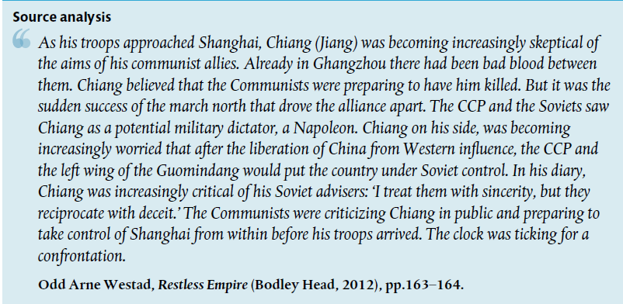

Slide 19
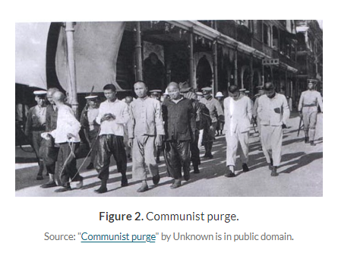
The White Terror
Historical background 1927-1949
The White Terror, also known as the ‘Shanghai Massacre’, was a crucial incident in the fight between the GMD and the CCP.
On 12 April 1927, the military forces of the Guomindang carried out a full-scale purge of communists in Shanghai, as well as in a number of other major cities in China.
The number of communists or suspected communists killed or wounded vary from 3,000 to 10,000. This coup almost succeeded in annihilating the CCP because many Chinese communist leaders were not willing to deviate from the Comintern order which was to maintain the alliance with the Nationalists at all costs.
The survival of the CCP was the result of a decision made by few communists to stop following the directive of the Comintern. They went underground and escaped to Jiangxi (Kiangsi) province. Mao Zedong was among them.

Slide 20
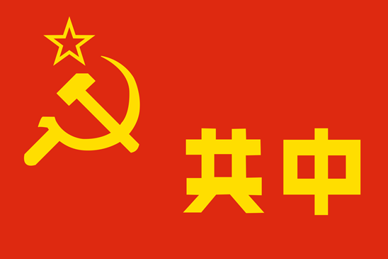
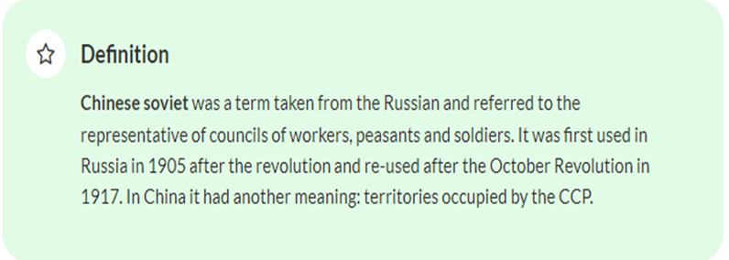
The Jiangxi Soviet

Slide 21
The Jiangxi Soviet
The CCP were forced to retreat into Jiangxi province in order to survive the GMD onslaught. This territory become known as the ‘Jiangxi Soviet’.
Mao’s writings suggest that the White Terror had only confirmed what he had already thought about the United Front: that this cooperation with the GMD would destroy the CCP. He also believed that the GMD and the Comintern had the wrong strategy for China, as they focused their revolution on urban areas. Mao’s revolution would be based on the peasants.
Essentially, this was a more realistic strategy, as the vast majority of Chinese were not urban workers but rural peasants. From a population in China of around 500 million, only 12 per cent were in urban areas, whereas 88 per cent lived in rural regions. From a total workforce of approximately 259 million, 205 million were agricultural workers and a mere 54 million were non-agricultural or industrial workers.
Mao arrived at Jiangxi and organized the Jiangxi Soviet around his idea of the central revolutionary role of the peasant – ‘The peasants are the sea; we are the fi sh. The sea is our habitat’, he stated. His ideological shift away from orthodox Marxism, which placed the proletariat at the centre of the revolution, put him at odds with more orthodox members of the CCP. But his success in recruiting and organizing the peasants in the Jiangxi Soviet began to win him the argument.

Slide 22
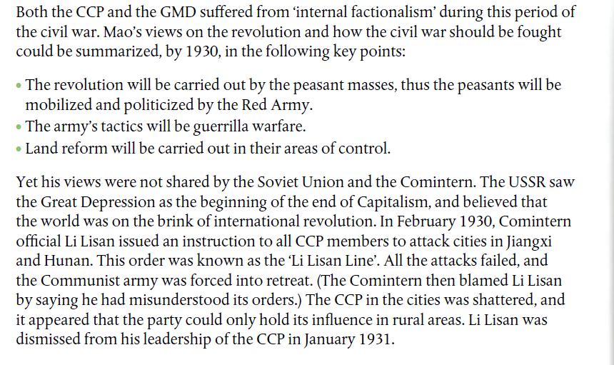
Divisions within the CCP

Slide 23
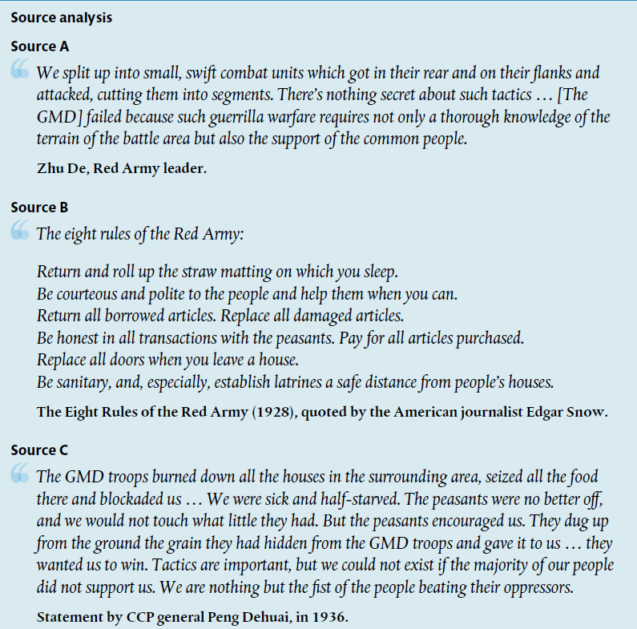

Slide 24
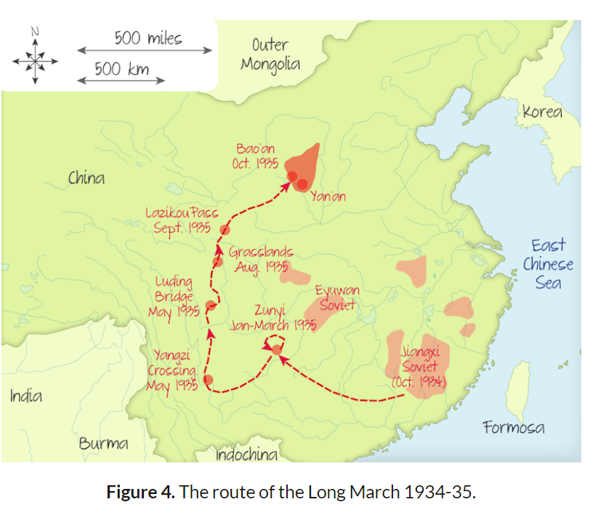
The Long March
In 1934, the communists were forced to abandon their base at Jiangxi to escape the constant attacks of the fifth encirclement campaign launched by the Guomindang (NRA) military forces. The communists needed to find a more secure location, so they started an incredible journey to Yan’an (Yen-an) known as The Long March.
They walked 13,000 km (8,000 miles) through 11 provinces, crossed 24 rivers and climbed 18 mountains while fighting the Nationalist army. They occupied 62 cities and towns. After a year, they reached Yan'an in Shaanxi (Shensi), with only 5,000 survivors from the 80,000 they had when they left Jiangxi.
This odyssey was significant because it symbolised the fight against stronger military forces (the Nationalists owned airplanes and had more weapons) but also the survival of the CCP. By 1935, Jiang Jieshi had not managed to complete his objective to annihilate the communists. One of the key consequences was the strengthening of Mao’s position.

Slide 25
The Long March
This event is significant for a couple of other reasons:
Mao Zedong managed to impose his idea of a peasant-based revolution.
Several other communists emerged as talented leaders: Deng Xiaoping (Teng Hsiao-p’ing), Lin Biao (Lin Piao), Zhou Enlai (Chou Enlai), Zhu De.
This odyssey was an amazing event in military history, however, it was a disaster in term of human life.
It was a propaganda success as the Red Army was able to spread communist ideology to the peasant population during the journey.

Slide 26
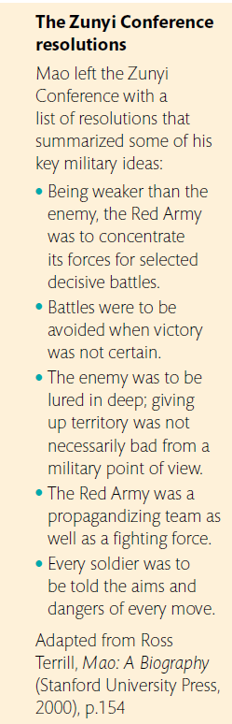
Key events of the Long March
Crossing the Xiang River
The Xiang River was strongly defended by the GMD, and Jiang was determined not to let the CCP escape. Mao criticized the strategy the CCP used at the river, where around 50,000 died. The CCP had not used his tactics of out manoeuvring and deceiving the GMD; they had also been loaded down with furniture and other unnecessary equipment. The 28 Bolsheviks, now in charge of the army, had simply led the CCP in a line into the river, where they were ‘sitting ducks’ for Jiang’s forces.
Zunyi Conference
In January 1935 the CCP, this time using guerrilla tactics, managed to capture the town of Zunyi. The 28 Bolsheviks had been discredited due to their disasters at Jiangxi and the Xiang River. At a party conference held here to determine future CCP policy, Mao established a much stronger hold over the party.

Slide 27
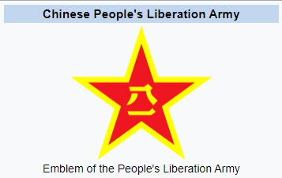
Key events of the Long March
Upper Yangtze River Crossing
At Zunyi, Mao ordered that his forces ‘march north to fight the Japanese’, and now led the Red Army towards Sichuan to meet up with the 40,000-strong Communist army under the leadership of Zhang Guotao. Jiang pursued Mao across the far-western provinces of Yunnan and Tibet.
The GMD destroyed all the boats at the Yangtze River crossing in an attempt to rout Mao’s forces. Mao deceived the Nationalists that his army was constructing a bridge to cross, but sent units to a town 136 kilometres further along.
Thus, while the bridge was being built, the CCP crossed the river in another place. Mao’s forces got across before the GMD realized what was going on.

Slide 28
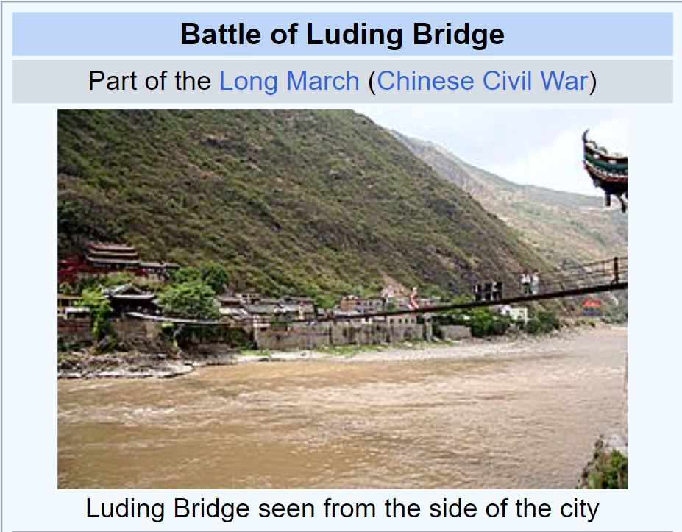
Key events of the Long March
The Luding Bridge
Just two weeks later, with Mao forcing the pace, covering 134 kilometres in just 24 hours, the Red Army came to the Dadu River. Local people had built a bridge, using their own resources to pay for it, from 13 heavy iron chains covered by wooden planks. The river was very fast moving, but here was the only way to cross. The GMD could, and should, have blown up the bridge, but this action would have led to local outcry. Instead, Jiang’s forces removed the planks that covered the chains.
What took place next is disputed. According to the CCP, 22 volunteers crossed the bridge, clinging on to the chains and lobbing hand grenades at the machine-gun posts that fired on them. Only five of the attackers survived, but they managed to take out the machine-gun posts, while those behind them laid new boards so that the Red Army could then rush across. In the ensuing battle, the GMD attempted to set fi re to the bridge, but it was too late.

Slide 29
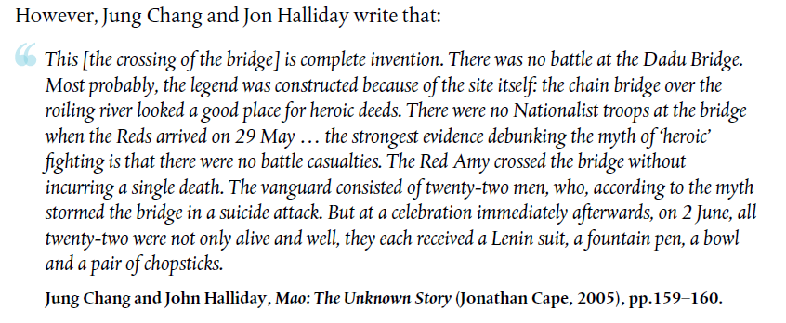

Slide 30
Key events of the Long March
Disputes between Zhang Guotao, Zhu De, and Mao
Mao had 10,000 left in his army, and this force finally met up with 45,000 men under the command of Zhang in Sichuan. The two leaders disagreed on what the Red Army’s next move should be. Mao wanted to go north to the Shaanxi Soviet, where they could fight the Japanese. Zhang wanted to stay in western Sichuan, or go further west to have closer access to the USSR. They could not agree and ended up going separate ways. Zhu De decided to go with Zhang, and the two generals took the majority of forces with them. The GMD attacked them, split their forces, and Zhu fled to join Mao. Zhang’s forces were virtually destroyed.
Songpan Marshes
To get to Shaanxi, Mao had to cross the unmapped and deadly Songpan Marshes, where men sank into the mud and drowned, faced attack from local tribes, and ate poisonous plants in an attempt to fend off starvation. Of the 10,000 that entered the marshes, only 7,000 made it across the 400-kilometre region.
Shaanxi
After marching 9,600 kilometres, and fi ghting 15 major battles and many smaller skirmishes, Mao’s army arrived at the Shaanxi Soviet in October 1935. Here they set up a Communist base centred on the town of Yan’an.

Slide 31
Mao and revolutionary warfare
Mao’s war against the GMD can be classed as a revolutionary war, as he was trying not only to defeat the GMD but also to impose a revolutionary ideology on the Chinese people. The choice the Chinese people had was between Maoism, with its total restructuring of society, economy and government, and the Nationalists’ policy, which basically involved maintaining the status quo. Mao believed that the peasants were central to revolutionary war, and so his priority had to be to persuade them to support the Communist cause.
Mao’s revolutionary warfare consisted of several stages:

Slide 32
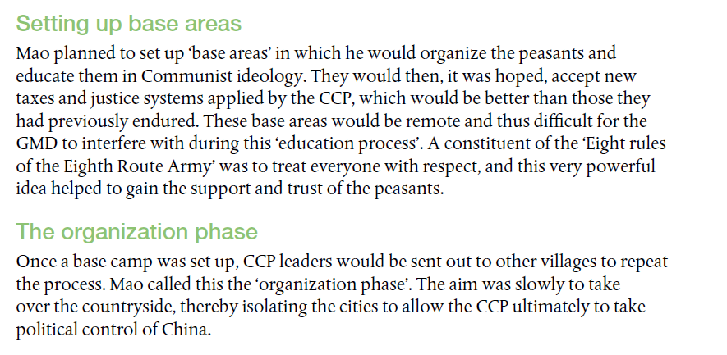
Mao and revolutionary warfare

Slide 33
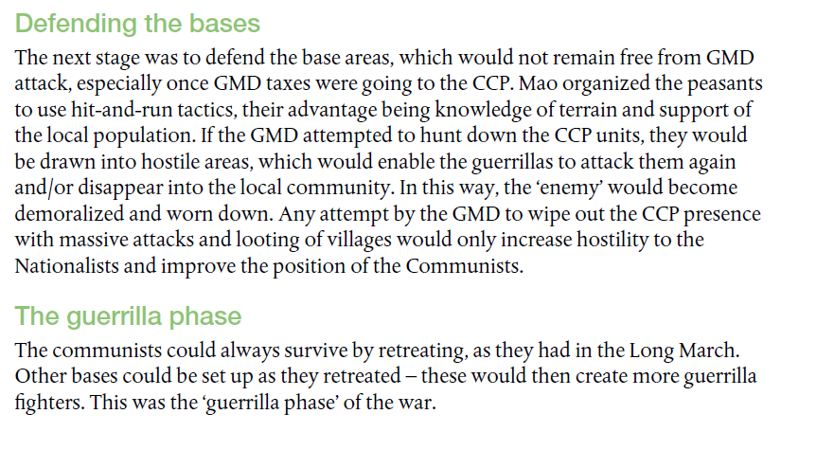
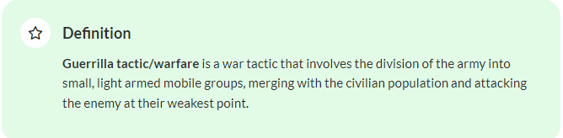
Mao and revolutionary warfare

Slide 34
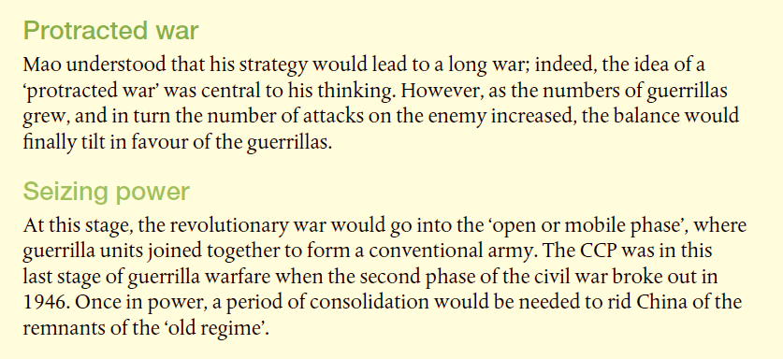
Mao and revolutionary warfare

Slide 35
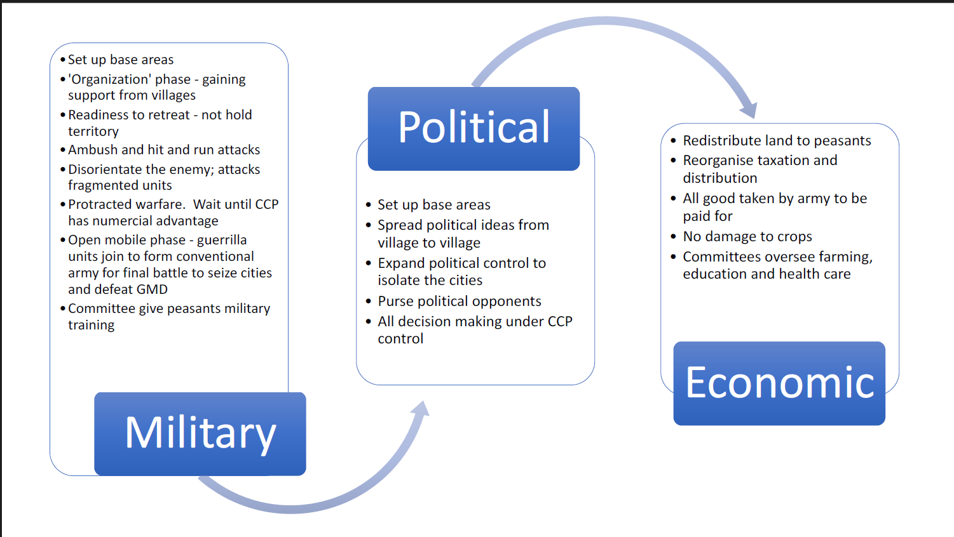

Slide 36
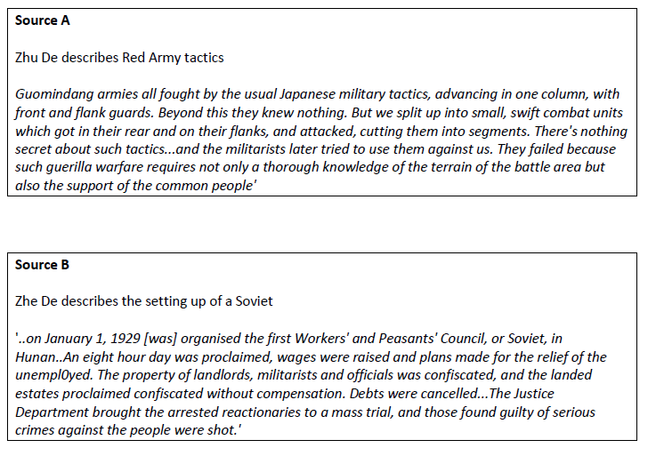
Guerilla warfare in the Chinese Civil War
1. In pairs review the definition of ‘guerrilla war'.
2. Read the sources below and make a note of the different aspects of the CCP's guerilla tactics. In pairs discuss why these would have been successful against the GMD

Slide 37
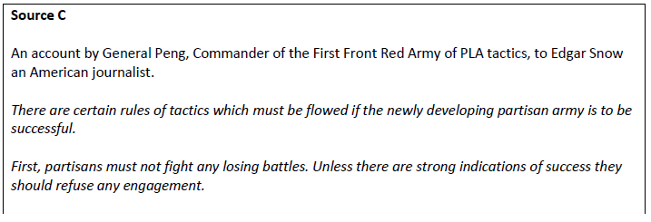
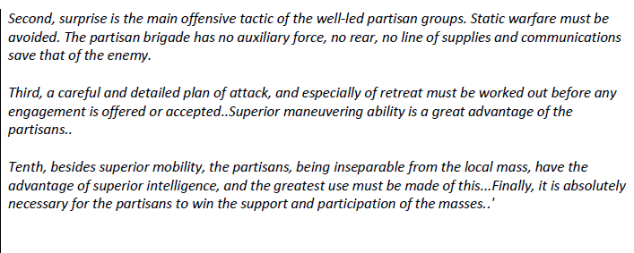
Guerilla warfare in the Chinese Civil War
1. In pairs review the definition of ‘guerrilla war'.
2. Read the sources below and make a note of the different aspects of the CCP's guerilla tactics. In pairs discuss why these would have been successful against the GMD

Slide 38
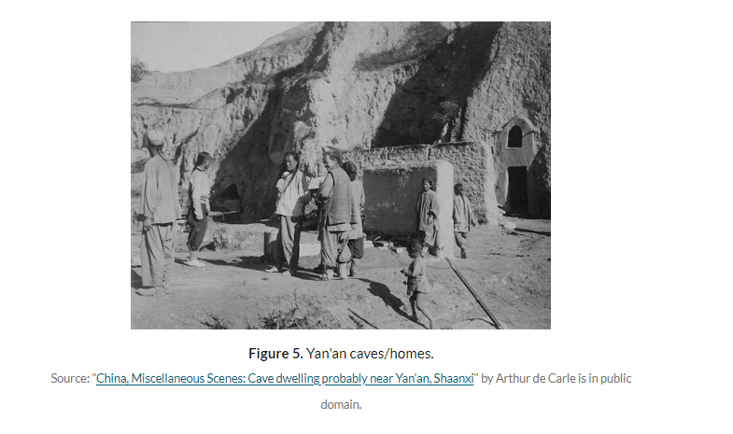
The Yan'an period
The end of the Long March led the communists to settle in Yan’an, a small town located in Northern Shaanxi (Shensi). It became the headquarters of the CCP from 1936 to 1949.
These years were significant for two main reasons:
1. During this period, the ‘Soul of the Chinese nation’ was born.
2. Mao imposed his leadership over his party but also over the Comintern, and created a mini communist Soviet.
Mao continued what he started in Jiangxi such as land reform and the teaching of the local peasants of the benefits of following communism ideology, but he also went further by fighting corruption among officials and introducing literacy and education programmes as well as basic health care. His policies were successful and the number of people joining the CCP kept increasing: 40,000 in 1937 to 80,000 in 1941 reaching one million by the end of World War II.
Persuasion and coercion had been used by Mao throughout his rise to power. For instance, the role of the Red Army was crucial in the early years of his ascent. They were a tool of propaganda to help spread the ideology of Communism to the masses.
The confiscation of the land from the landlords to be redistributed to the peasants was another persuasive tactic to impose the communist ideology in the countryside. Peasants were willing to follow a leader inclined to look after their well-being.
However, Mao Zedong also instilled fear in the population. The political system established in Yan’an was an oppressive and dictatorial system. Stricts rules and regulations were implemented and peasants who did not follow them were punished (for example, their land could be confiscated).

Slide 39
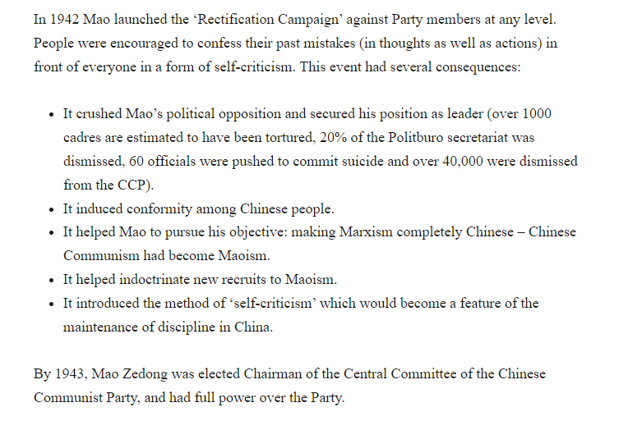
The Yan'an period

Slide 40
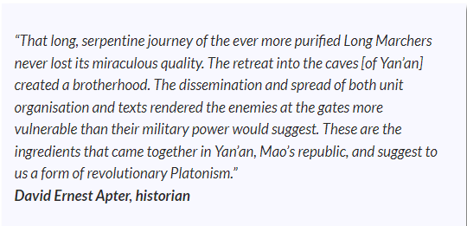

Slide 41
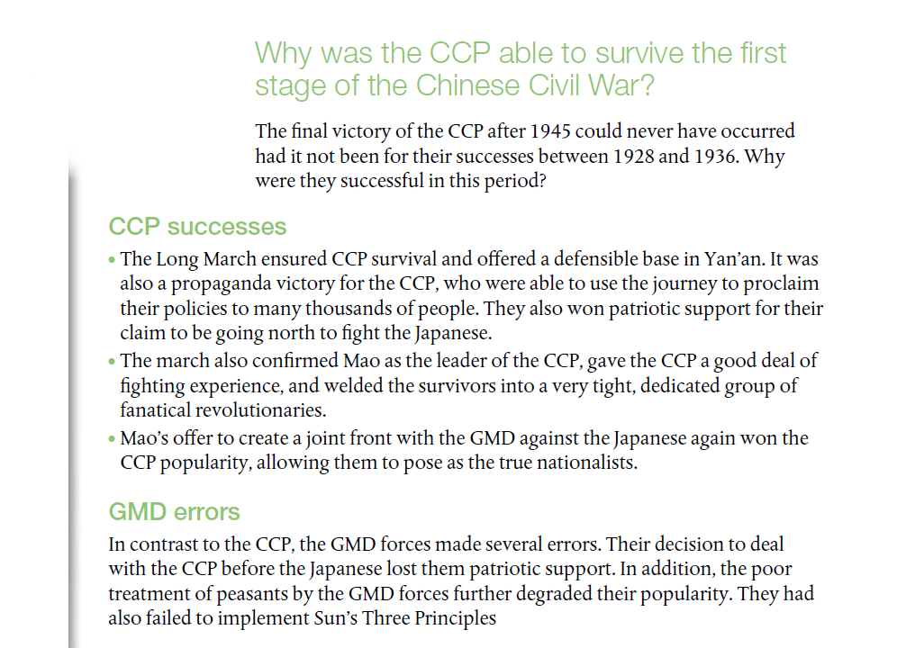

Slide 42
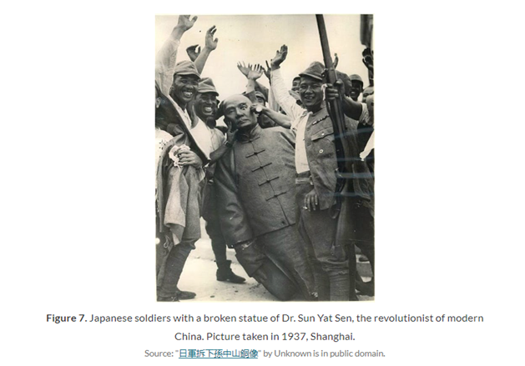
End of the first stage of the Chinese Civil War and the Second United Front, 1937 The enemy of my enemy is my friend season II
In July 1937, when Japanese forces launched a full scale attack on China, they were already in possession of Manchuria (renamed Manchukuo since 1931). By September 1937, the Japanese had easily defeated the Chinese Nationalist Army in Shanghai and continued to invade and conquer China.
In December 1937, they entered Nanjing and the notorious Rape of Nanjing took place. Between 20,000 and 80,000 women were raped and an estimated 200,000 and 300,000 Chinese were killed. Canton, Beijing and Wuhan were captured in 1938.
By 1939, most of the coastal and eastern part of China was under Japanese control while the GMD and the communists took refuge in western China. From the beginning the Chinese army was unable to resist the Japanese forces. They only had few mechanised divisions, no significant armoured units, no air force and they relied mainly on imported weapons from the West.
At the beginning of the war, the communist forces were incorporated into the Nationalist Revolutionary army. They united as part of the Second United Front in order to fight their common enemy. They formed the Eighth Route Army and the New Four Army and used guerrilla tactics to compensate for the lack of military equipment.

Slide 43
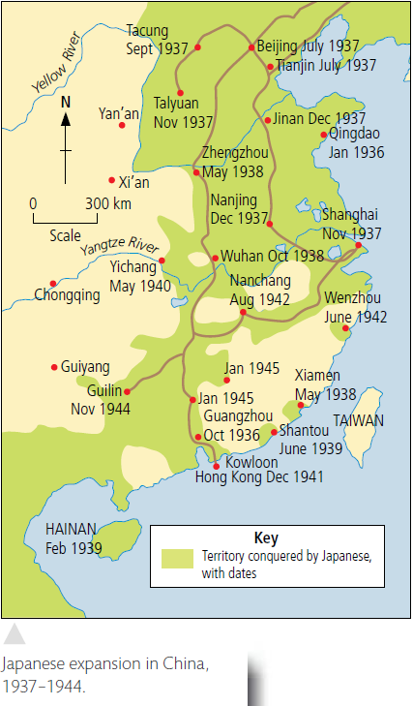
End of the first stage of the Chinese Civil War and the Second United Front, 1937 The enemy of my enemy is my friend season II
The main objectives of the guerrilla tactics were to delay, interrupt and sabotage Japanese military activities and to prevent the enemy from occupying more Chinese territories. In order to reach these goals, communication systems such roads, airfields, bridges and military trains and infrastructure, such as warehouses which housed Japanese army ammunition and fuel supplies were targeted and destroyed.
The communists were often successful using these tactics because they attacked when the Japanese expected it the least, had excellent local knowledge and were sheltered by the local population when needed. The use of this tactic benefited the communists in different ways. It meant they captured weapons and munitions they could use against the Japanese. They also attracted and recruited more Chinese people to Communism.

Slide 44
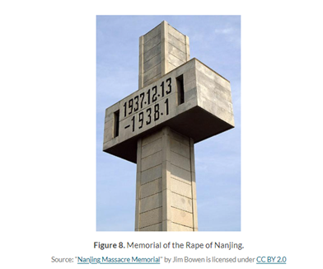
End of the first stage of the Chinese Civil War and the Second United Front, 1937 The enemy of my enemy is my friend season II
In August 1940, the communists deviated from their usual tactics and launched a full scale offensive against the Japanese known as the ‘100 Regiments Offensive’. The Red Army under the command of Peng Dehuai launched a series of attacks against enemy forces located in Hebei (Hopeh) and Shaanxi (Shensi). This offensive, which involved 400,000 men in 15 regiments against 250,000 Japanese, lasted from August to December 1940 and was successful.
The Japanese transport system was disrupted with over 950 km (600 miles) of major roads and railway lines destroyed. This success was short-lived. In December the Japanese forces retaliated against the local population, known as being communist sympathisers: people were murdered, women were raped, whole villages were destroyed and over a quarter of the communists killed. Following the counter-attack, Peng Dehuai received much criticism and Mao Zedong dismissed him from his commander position until the end of the war.
After the 100 Regiments Offensive the power of the CCP increased. By 1945, most of the countryside had been liberated from Japanese control and the communists were implementing land reforms, promising a unified China, peace and stability. Many more peasants and even intellectuals joined the CCP.

Slide 45
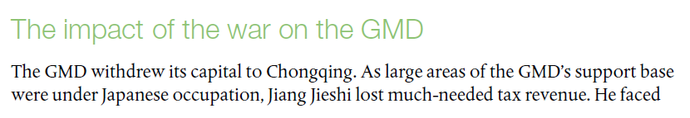
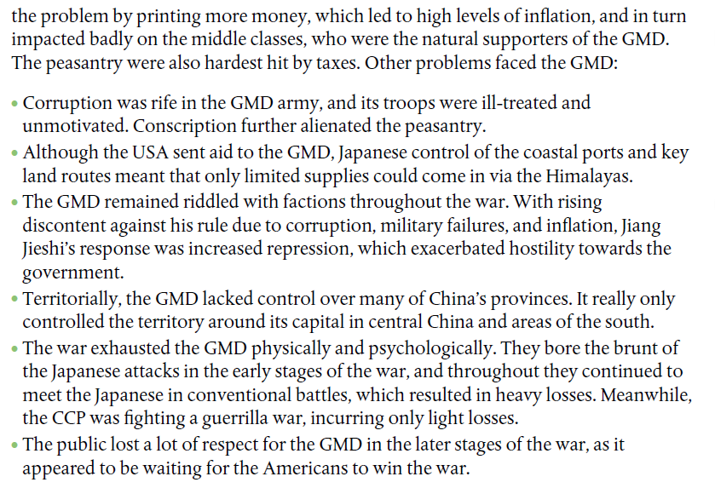
The Sino-Japanese War

Slide 46
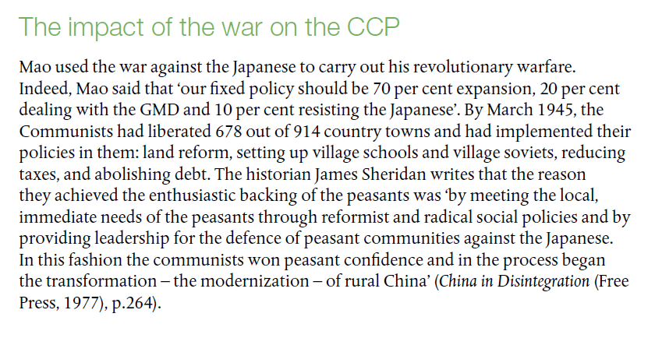
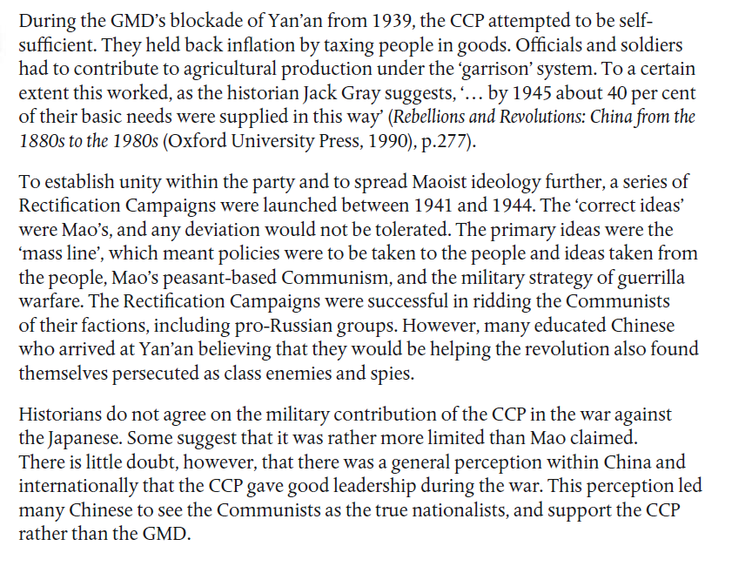
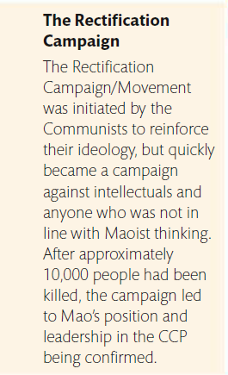
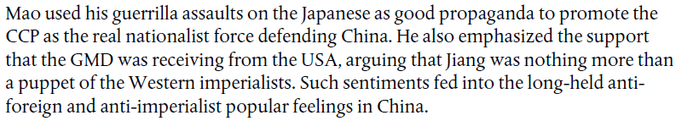

Slide 47

World Perceptions on the Rape of Nanking

